Slide 1
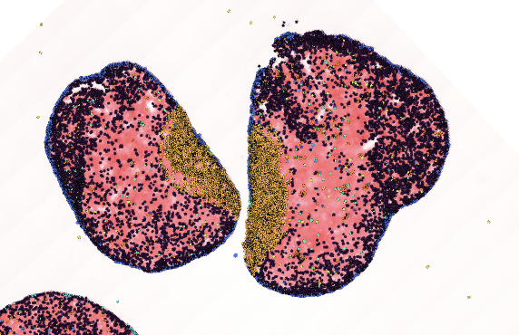
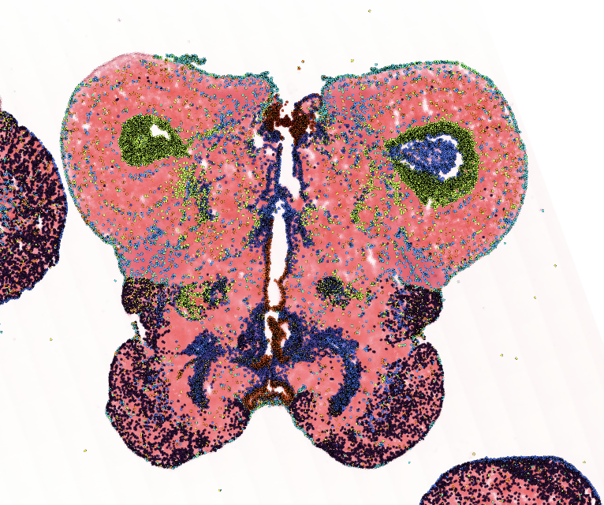
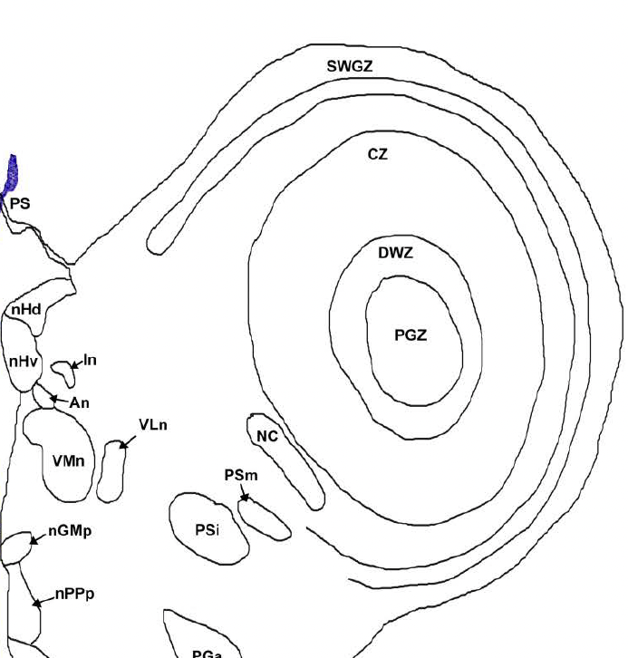
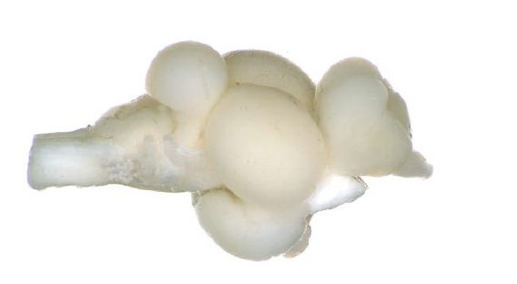

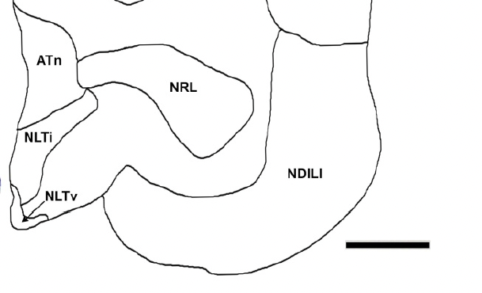
4P5_D1_A1
4P5_D1_A2
Truthfully these ones I have no clue clearly theyre anterior but nothing looks
like them and has a similar nissl pattern
4P5_D1_B1
4P5_D1_B2
19
19
24
24
25
25
I think both hemispheres are in the same plane but this one is more posterior but not enough to change the sections

Slide 2
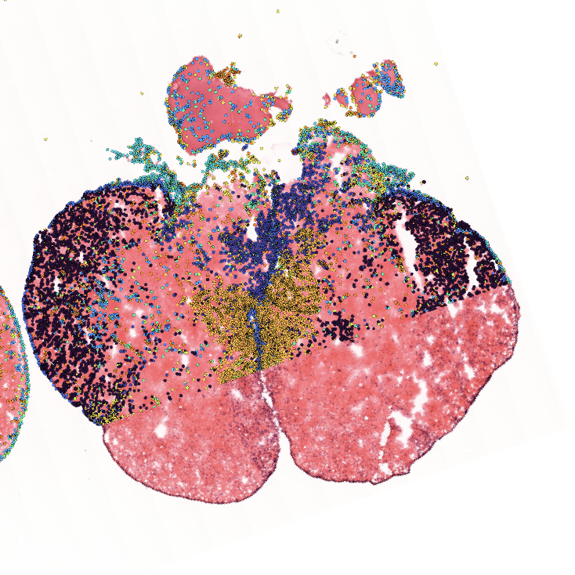
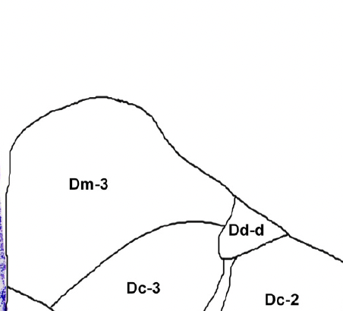
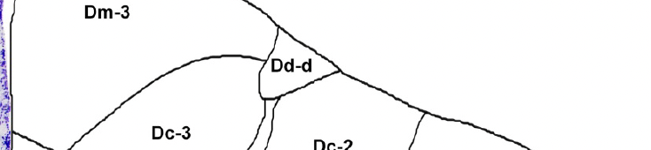
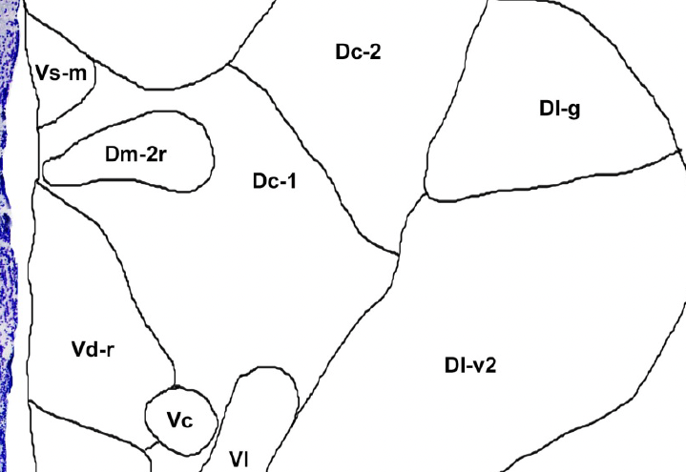
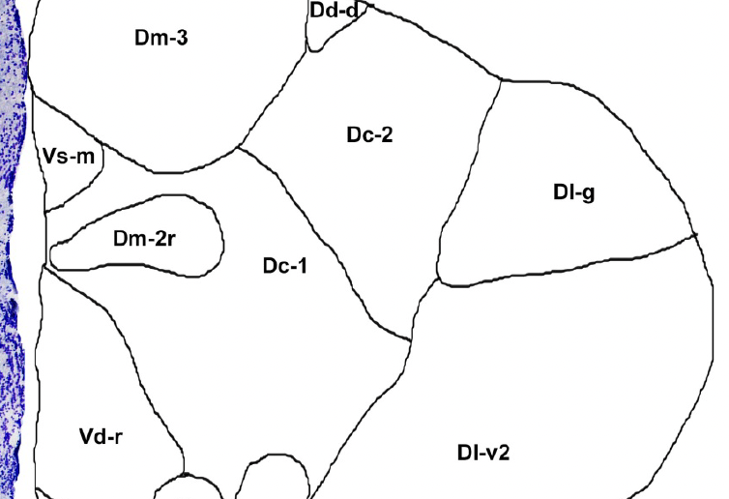


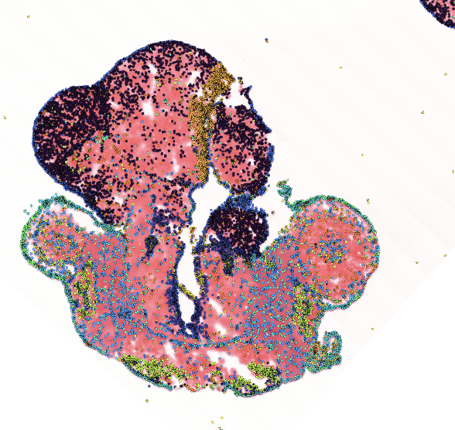
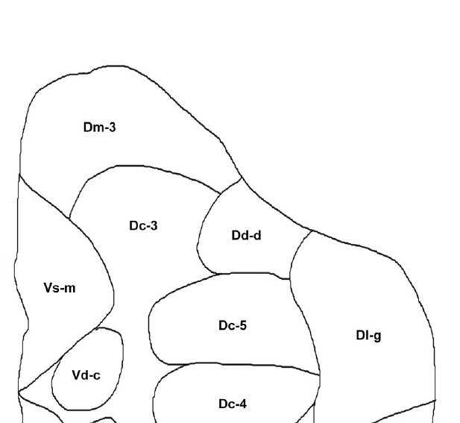
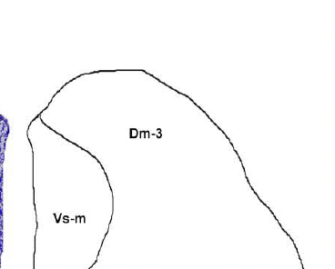
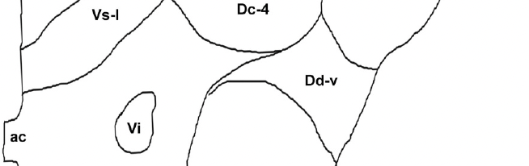
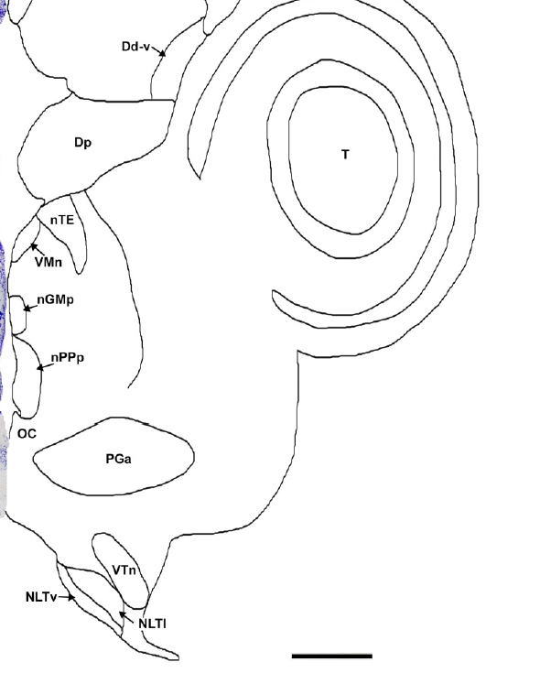

4P5_D1_C2
4P5_D1_C1
Not super confident about this one cause
There should be an arrowhead structure
here
Probably part of Dm
Maybe this is more accurate?
10
10
9
7
7
6
8
Cant explain this missing divot
4P5_D1_D2
4P5_D1_D1
16
12
Im really guessing here
13
18
15

